Slide 1
A managerial philosophy of technology :
Technology and humanity in symbiosis
Geoff Crocker,
Author ‘A Managerial Philosophy of Technology’
April 2016

Slide 2
CONTENT
The significance of technology
The philosophy of technology
Defining technology
Hypothesis – technology can only be understood in a systems network model
Hypothesis – a predictive economic algorithm determines the implementation of technology
Hypothesis – technology as artefact is both objective and subjective
Challenge – a phenomenological philosophy of technology requires wider database to develop explanatory hypothesis

Slide 3
PERSPECTIVES
Practitioner > philosopher
Ie database of technology emerging and happening, asking about theory
Empirically led > theory led
ie phenomenological > Feenberg
Continental philosophy > Anglo/American
ie ‘wondering about technology’ > epistemology/methodology
Popperian > Kuhnian
ie hypothesis > paradigm

Slide 4
The significance of technology
Technology
  determines human existence (beyond the garden of Eden)
  determines human life expectancy
  determines human life experience
  determines human ontology – we are cyborgs!
  is essentially symbiotic with humanity
therefore deserves more widespread shared attention
  Academia
  Industry
  Government
  Media
  Public debate

Slide 5
The significance of technology
Significant questions about technology
Technology drives productivity which determines prosperity and profitability
High tech high productivity economies can demonstrate macroeconomic demand deficiency when productivity > real wages (current world economic crisis)
  See ‘The Economic Necessity of Basic Income’
  www.centreforwelfarereform.org/library/by-date/the-economic-necessity-of-basic-income.html
  See ‘Keynes, Piketty and Basic Income’
  www.degruyter.com/view/j/bis.2015.10.issue-1/bis-2015-0015/bis-2015-0015.xml?format=INT
Is technology autonomous or manageable?
How can we manage technology?
Do we have any choice?

Slide 6
Philosophy of technology
- the academic literature
 | Contributor
Definitions of technology
Rationalisation | Andrew Feenberg
Human enhancement | Philip Brey, Nick Bostrom
Cyborg ontology | Donna Harraway
Instrumentalism + intentionality vs substantive view of technology | Mario Bunge, Keekok Lee, David Kaplan
Philosophical analysis of technology
Determinism | Karl Marx, Robert Heilbroner
Autonomy | Jacques Ellul, Albert Borgmann
Social constructivism | Trevor Pinch and Wiebe Bijker critic Langdon Winner
Technocracy | Andrew Feenberg, C P Snow
Dystopia | Martin Heidegger, Herbert Marcuse Hans Jonas
New conceptualisations of technology
Phenomenology | Don Ihde, the Dutch school
Moderation of technology
Saving grace | Martin Heidegger
Catholic faith | Jacques Ellul
Focal things and practices | Albert Borgmann
Democratisation | Jorgen Habermas, Andrew Feenberg
Correctly conceptualising technology | Heidegger suggests but fails to define. Therefore a definition is offered in a ‘Systems Network Philosophy of Technology’

Slide 7
Definitions of technology
Definition of technology | Critique
Rationality ‘the sum of rational means employed in society’ | Distinguish intrinsic rationality of technology from application rationality Application of technology can be rational too Technology is rational only because nature is rational So rationality is a definition of nature, not of technology Humanity is holistic, not only rational Humans have subjective, even irrational, values and objectives Post-modernity challenges the dominance of rationality Humanity engineers technology, so technology may not be totally rational
Human enhancement Technology as tool | OK for hammer but not for complex system Need to define what extends human power ie not a definition at all Technology can reduce human power eg AI according to Dreyfus Once operationally independent of human power this definition fails
Cyborg Humans are techno-human | A definition of humanity, not of technology ‘Cyborg minus human= technology’ doesn’t work as a definition
Instrumentalism Technology subject to human intentionality Technology is value free Human agency is determinative | Technology developments can surprise and even contradict human intentionality Applications of technology can also contradict elements of human intentionality Technology adoption is often unnoticed ie hardly intentional The technology process is more substantive than instrumentalism allows
PREFERRED DEFINITION | The Cognitive Reconfiguration of Natural Materials and Processes

Slide 8
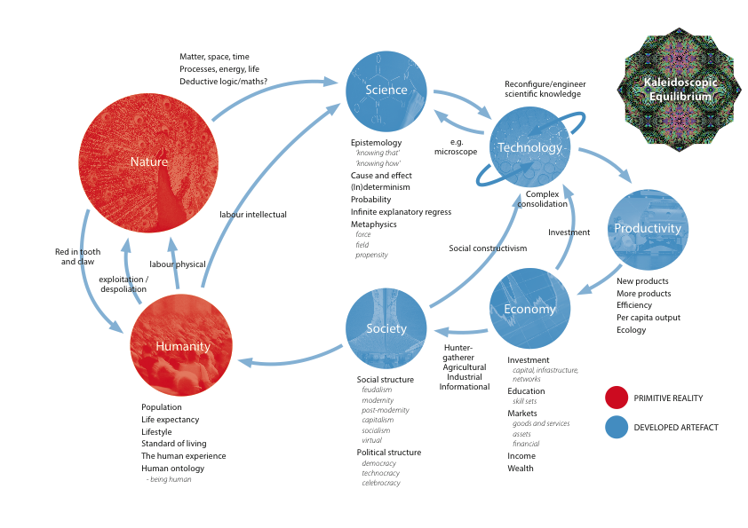
Claim – technology can only be understood in a systems network model
Notes:
s

Slide 9
Claim – a predictive economic algorithm determines the implementation of technology
Market
Economy
Technology in a market economy has migrated
upstream
globally
to large private sector specialised global technology suppliers
Technology is market contingent and follows a determining algorithm
Technology must have a positive downstream economic rent (IFF)
Technology must have competitive price/performance vs other technologies (IFF)
Technology must have viable value chain route to market (IFF)

Slide 10
Claim – a predictive economic algorithm determines the implementation of technology - examples
Technology | Application | Market | Business case? | Competitive price/performance ? | Viable route to market ?
IBM smartcard | Payments credit/debit | EU, Asia | √ | √ | √
 |  | US | X | X | X
 | Payments cash | Global | X | X | X
 | Loyalty | Global | √ |  | √
 | Air tickets | US, EU | √ | X | √
 | Health data | US, EU | √ | √ | X
 | Passport/ID | Global | √ | ? | X
Pechiney thixotropic aluminium | Carburettors | US, EU | √ | √ | X
 | Aerospace | US, EU | √ | √ | X
 | Disk drives | Asia | √ | √ | X
BUT NEEDS A STOCHASTIC MODEL – THEREFORE A PORTFOLIO ☺

Slide 11
Developing a phenomenological philosophy of technology
Technology narratives
Textiles
Technology
Textiles technologies
UK C18th textiles technology development
1733 John Kay’s flying shuttle – ‘the first technology to achieve a quantum leap in productivity’
1764 James Hargreaves’ spinning jenny - spinning yarn for weft
1769 Richard Arkwright’s Cromford water frame – spinning yarn for warp too
1779 Samuel Crompton’s mule
1830 Richard Robert’s power loom – ‘a completely new epoch in the capitalist system’ (Marx)
Deployment slow : 50 years before power loom = >50% UK cotton output
1800-1842 UK textiles output x 6 ! 50% UK textiles machinery exported to Russia, India, Germany

Slide 12
Developing a phenomenological philosophy of technology
Technology narratives
Agricultural technologies
J L Anderson ‘Industrialising the Corn Belt – Agriculture, Technology and Environment’
1945 US farmer output for 11 people : 1970 for 42 people
From 20m acres, 1945 462m bushels corn, 11m pigs : 1970 858m bushels, 18m pigs
1947 DDT spray against corn borer insect, 1960s insect resistant, 1970 DDT banned
1949 41% farmers used pesticide, 1962 Rachel Carson’s ‘Silent Spring’, 1964 Pesticides Act
2.4-D hormone growth regulator for weed control, Atrazine raised yield to 19 bushels/acre
1945 419m tons N + 435m tons potash : 1970 7,459m tons N + 4,025m tons potash
Antibiotics (Stilbestrol banned 1973), confinement
Era of cheap available food
Agricultural
Technology

Slide 13
Developing a phenomenological philosophy of technology
Technology narratives
Agricultural technologies
February 2011 Economist review of world agricultural technology and productivity
Will agriculture be able to feed a world population of 9bn in 2050?
Low tech wheat field = 1-2 t/acre : green revolution field 4-5 t/acre : best practice field 10 t/acre
Human need 2,100 cal/day 90g meat/day (UNFAO) : total current output twice this requirement
Meat, dairy and veg = 20% calories 2000 to 29% 2050 ; meat production must double to 470mt
Crop yield growth 3% pa in 1960s, 1% pa in 2010 : world population growth = 1.2% pa
Rice and maize output needs 1.5% pa growth, wheat needs 2.3% pa growth
Climate change could reduce crop yields by 9-18% by 2050
Land is available : 0.5bn hectares in S America+Africa
Land use must improve eg west Europe 9 t/acre wheat : east Europe 2-4 t/acre
Water is constraint : 4,500 Km³ pa global consumption vs 4,200 Km³ pa available = water tables falling
Agriculture needs +45% water by 2030
Fertiliser use = 10Kg/hectare Africa, 180Kg/hectare India
30-50% food production lost in poor logistics, refrigeration etc
World can feed 9bn population by 2050 but only with GM technology!
Agricultural
Technology

Slide 14
Developing a phenomenological philosophy of technology
Technology narratives
Propulsion
Technology
Propulsion technologies
Steam engine
1690 Denis Papin steam engine
1698 Thomas Savery, 1712 Thomas Newcomen steam engine water pump
James Watt separate condenser = 75% less fuel
1800 Richard Trevethick high pressure steam engine
Steam engine = main railway traction technology up to mid C20th + ships
1938 Mallard record 202.58 Km/hr
Internal combustion engine
1900-1981 600 innovations : increase power/weight car , strength/weight materials
Electric motor
1955 Japanese AC motors for 1964 Shinkansen train 210 Km/hr, 300 Km/hr 1997
TGV Atlantique 515.3 Km/hr 1990
Gas turbine aero engine
Frank Whittle UK, Hans Pabst von Ohain Germany
Technology drove modal choice car/train/plane by journey time

Slide 15
Developing a phenomenological philosophy of technology
Technology narratives
Fuel cell
Technology
Fuel cell type |  | Efficiency | Operating temperature | Characteristics | Applications
AFC | Alkaline fuel cells | 60% | 80ºC | Older technology Needs pure fuel | Space programme
PAFC | Phosphoric acid fuel cells | 55% | 200ºC | Large, heavy Slow warm up >90% efficiency for CHP | Power generation
PEM | Proton exchange membrane cells Polymer electrolyte fuel cells | 55% | 80ºC | Low temperature Low weight Fast start up | Automotive
SOFC | Solid oxide fuel cells | 50% | 1000ºC | Very high temperature Can use other fuels | Developmental
MCFC | Molten carbonate fuel cells | 55% | 650ºC | Very high temperature Corrosive electrolyte | Developmental
Zero emissions, silent operation, high reliability, high cost
Ballard Power Systems cost reduction by carbon silk catalyst, Solupor membrane
2008 Honda Clarity car 60% tank to wheel efficiency (cf 22% standard diesel car)
Prototype buses, cars, motorcycles, powergen
2009 US government discontinued funding Hydrogen Fuel Initiative Programme

Slide 16
Developing a phenomenological philosophy of technology
Technology narratives
Medical
Technology
Antibiotics, antipyretics, anaesthetics, anti-depressants, NSAIDs, antivirals
Smallpox eradicated, but 781,000 malaria deaths in 2009, mainly children
$1.8bn annual malaria prevention spend needs to rise to $6bn to eradicate by 2015
European €60bn medical technology market
Pharmaceuticals sector very concentrated, other medical technologies very fragmented

Slide 17
The phenomenon of innovation
Joseph Schumpeter typology of innovation
  new products
  new production methods
  new sources of supply
  new markets
  new business organisation
Eras of innovation
  1780-1840 industrial revolution, factories, textiles, canals
  1840-1890 age of steam and railways
  1890-1940 age of electricity and steel
  1940-1990 age of mass production
  1990 – now information technology age
Four quantum leaps
  UK industrial revolution
  German and US industrial development
  Japanese industrial productivity
  US electronics sector

Slide 18
Elements of each era of innovation
UK industrial revolution
  An engineering phenomenon – no real R&D for technology development
  No effective IPR protection
  By 1850, productivity and standard of living in UK 50% > elsewhere
  Problem of family firm with next generation management
  Problem of focus on Empire
German and US industrial development
  US separated ownership from management – IPOs and 1908 Harvard ‘MBA’
  German and US in house R&D
  1913 German engineer training = 3,000 graduates/year : 350 in UK
  Large electrical firm model AEG, Siemens, General Electric, Westinghouse
Japanese surge
  Cross shareholding
  High gearing 7:1 supported by Bank of Japan
  Lifetime employment
US Silicon Valley phenomenon
  Entrepreneurial technology culture, stock based remuneration
  Venture capital, the innovating firm

Slide 19
Factors driving innovation
Enabling and encouraging firms to behave innovatively
Creating and fostering networks of innovation
Harnessing university contribution to innovation in industrial partnership
The availability of venture capital finance
The existence of protective IPR
The nurturing of geographical clusters of innovation
Understanding ‘path dependency’ of technology, and avoiding its constraint
The understanding of the global nature of innovation

Slide 20
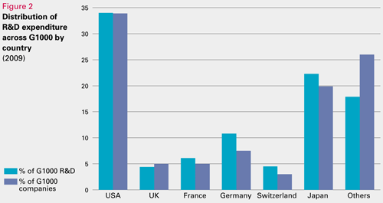
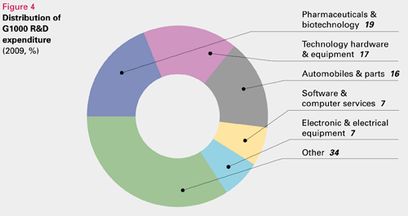
Phenomenon
The management of technology in a market economy
UK R&D Scoreboard
  2009 leading 1,000 world companies = £344bn R&D spend
  82% in 6 countries : US, Japan, Germany, France, Switzerland, UK
  52% in 3 industries : pharmaceuticals/biotechnology, technological equipment, automotive

Slide 21
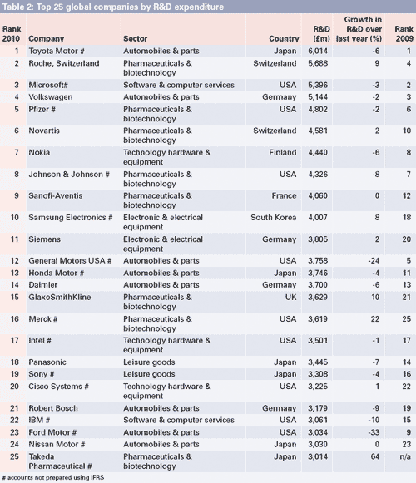
Phenomenon - Private sector led technology development

Slide 22
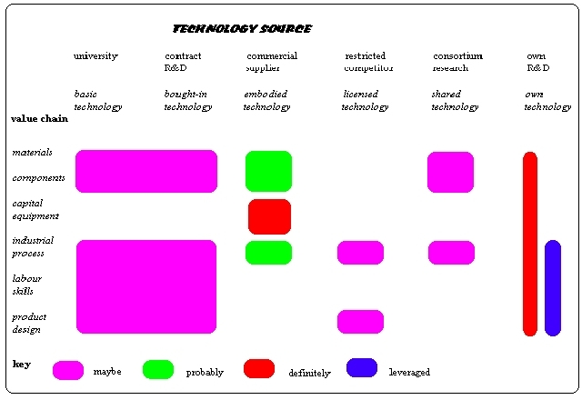
Phenomenon – sources of technology

Slide 23
A Phenomenological Philosophy of Technology ?
The phenomena of the previous slides requires explanatory theory
= the task of a philosophy of technology ?
Phenomenon requires theory
Theory requires phenomenon
ie extensive database

Slide 24
Resolving the model
– the main contingencies
Technology = The Cognitive Reconfiguration of Natural Materials and Processes
Existent technology is contingent on nature and humanity
Applied technology is contingent on society and market artefacts
Society and the economy are technology contingent
Nature’s ecology and humanity’s ontology are impacted by technology and are therefore also technology contingent

Slide 25
Resolving the model
– the main direction
CONSTITUENTS OF TECHNOLOGY | AVAILABLE TECHNOLOGY | DETERMINANTS OF APPLIED TECHNOLOGY | APPLIED TECHNOLOGY | TECHNOLOGY IMPACT

Slide 26
Reflections for the Philosophy of Technology
Phenomenology
Supervenience
Democratisation
The autonomy of artefacts eg market eg technology

Slide 27
References
A Managerial Philosophy of Technology
Technology and Humanity in Symbiosis
Free Download at
www.philosophyoftechnology.com
Technology Market Strategies
www.tms.eu.com

